Slide 2
ListView
You can drop ListView from legacy tab of your palette.
Set the height as wrap_content to expand the list as long as you have item’s list.
Set the width of your list as match_parent to make the list as wide as your layout is.
You can adjust the height and width of your own choice by giving the values in dp.

Slide 3
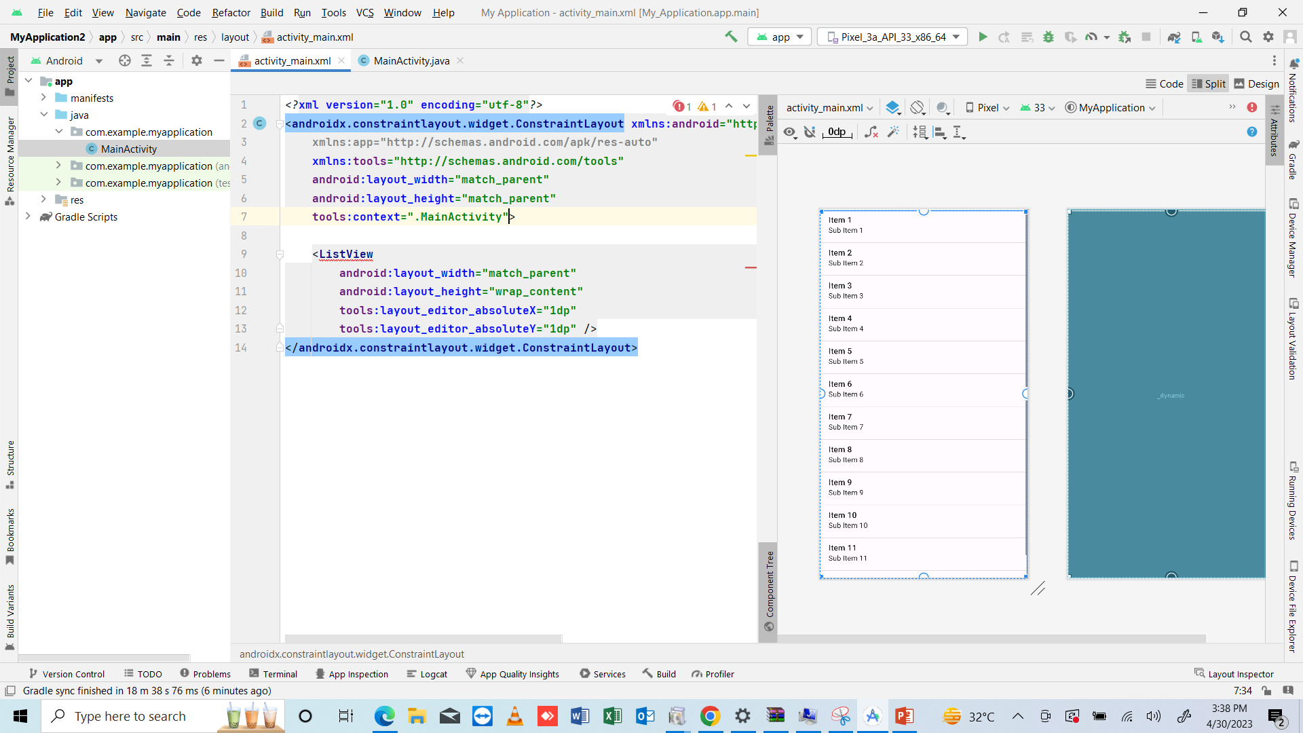

Slide 4
Java file
A list has been added, now open the java file to code.
Creat a variable of ListView type and pass the id of your list using findViewById method.
We can add list item using array or arrayList. Array is not dynamic means it has fix length. Array list can be expanded at run time when you exactly don’t know total data items to be stored.
So we will use ArrayList. So we create an ArrayList in java, we have to give the data type of ArrayList as well in <>angle brackets.
Syntax: ArrayList<data_type> array_name = new ArrayList<>;
This dynamic list will allow to add as many data items in it as you wish.

Slide 5
To add data in ArrayList
We use add() method to add data in the ArrayList.
Syntax: array_name.add(“data”);
Note: We add data in ArrayList under setContentView.
Now add as many items as you want.
Now we have to use this ArrayList. There ae two ways to do so, one is add every element manually or use android array adapter to add all the items.
Adapter is used to set the ArrayList in the andoird ListView.

Slide 6
ArrayAdapter
Note: we will do the following code under setContentView
To create the ArrayAdapter use the following java syntax.
Syntax: ArrayAdapter<data_type> name_of_adapter = new ArrayAdapter (class_name, TextView_layout, array_name);
Code: ArrayAdapter<String> adapter = new ArrayAdapter<>(getApplicationContext(), android.R.layout.simple_list_item_1, arrFruits);
Note: the data type you choose for ArrayAdapter should be same as the data_type of ArrayList. We have created String type ArrayList, so the ArrayAdapter must be of String type.
Note: class_name means the class where you want to call it, we have three ways to class the class:
MainActivity.this
this
getApplicationContext()
In this example I am calling getApplicationContext, because we have already tried the above two ways to call the same class.
To set the text in the list, ArrayAdapter needs a layout that can be used to set the text, in android we use TextView to set the text. we do not need to create TextView layout, we just need to call that already created TextView Layout here.
To call the already creadted layouts we use “android.R.layout.ListView” //we will use first list available in pop-up.

Slide 7
Setting up the ArrayAdapter on ListView
Now after creating ArrayAdapter we have to set that to ListView so that we can use it to add data items in ListView.
Synatx: listView_variable_name.setAdapter(adapter_name);
Code: myListView.setAdapter(adapter);

Slide 8
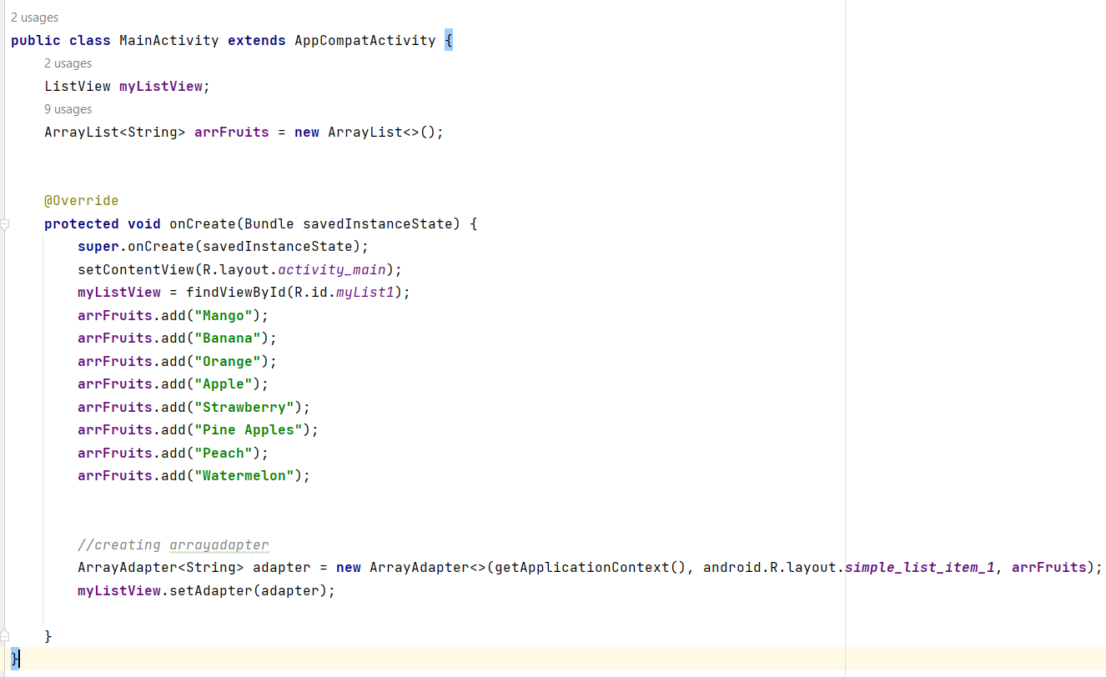

Slide 9
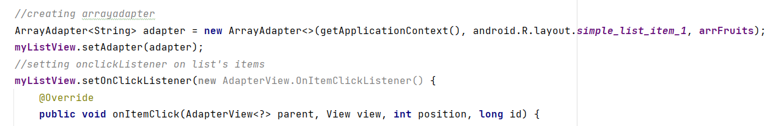
To make the items of list as clickable
We will use setOnClickListener for items to do so.
Syntax: list_variable_name.setOnClickListener(new AdapterView.OnItemClickListener() //just take the first option and class will created automatically.
Code: myListView.setOnClickListener(new AdapterView.OnItemClickListener() {
In the above code, position means the position of each text in the list, as we will need to set different things against click on each item.
We can use position of every item using if(position==0) and so on.

Slide 10
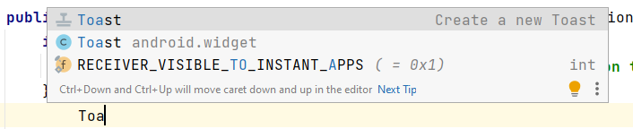
How to set position
You can set position of every item in the list one by one.
The first item’s index is 0, the second item’s index is 1, the third item’s index is 2 and so on.
You can do whatever you want to do on clicking the item name by using if, else-if structure in java.
Here in example I am using Toast, on the click of every item in list.
I use Toast to show a message, take the Toast from popup, the whole syntax will appear automatically.
You can use intent to move to another activity where you can explain each item, or show the image, or show details etc.
Toast is explained in upcoming slides.

Slide 11
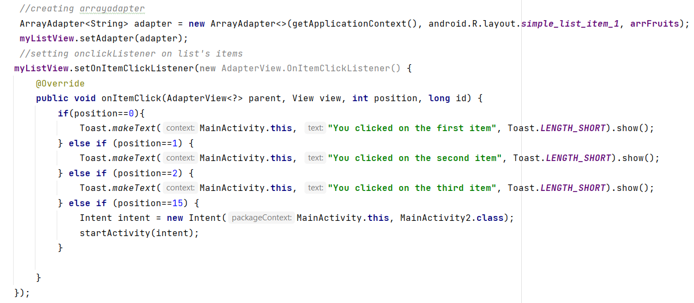

Slide 12
What is a Toast in android
A toast is a short, informational message that an app displays briefly near the bottom of the screen.
Only one toast can be displayed at a time.
The toast tells a user about an action the app has taken or will take.
It does not require any user action or response.
After 8 seconds, the toast disappears automatically.

Slide 13
Spinner in Android

Slide 14
Spinner- Introduction
Spinners provide a quick way to select one value from a set.
In the default state, a spinner shows its currently selected value.
Touching the spinner displays a dropdown menu with all other available values, from which the user can select a new one.
You can add a spinner to your layout with the Spinner object.

Slide 15
How to add Spinner in Project
I added a linear layout first.
To add the spinner, first of all we need a heading that will help the user what he list is about.
So add a TextView. Give a text, you can adjust text size, style, color etc.
Then add a Spinner from containers tab in the palette.
Set the id for spinner, coz we will be using this id in our java file.
That’s all for layout, now we will code in java file.
XML file has been pasted in the next slide for the reference.

Slide 16
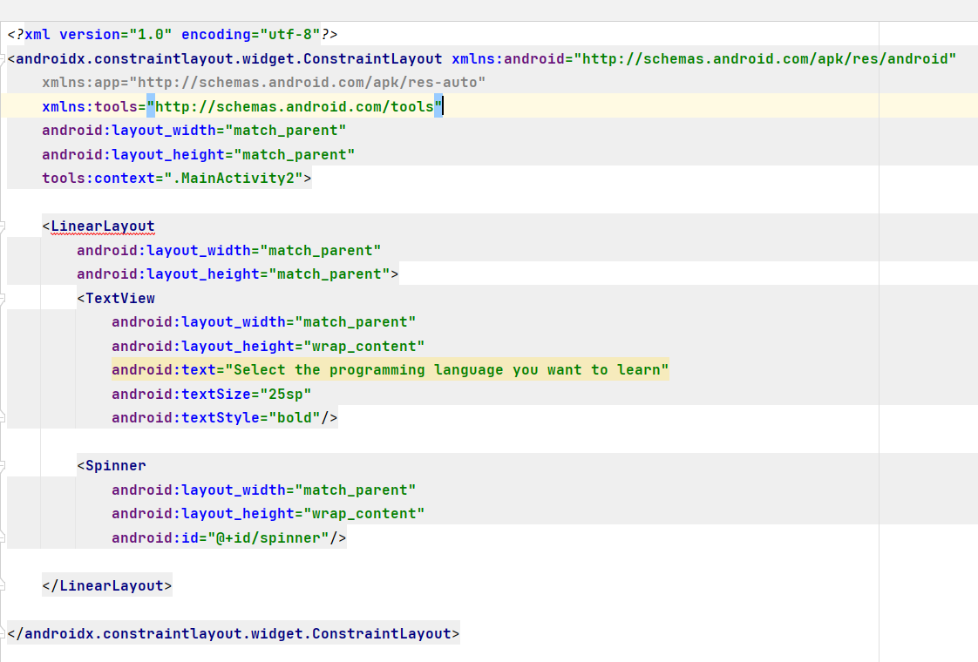

Slide 17
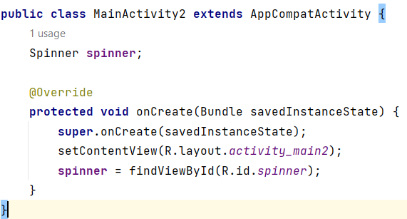
Let’s code in java file
Create a variable for Spinner.
Syntax: Spinner var_name;
Code: Spinner spinner;
Now give the id of the spinner under setContentView portion by using findViewById method. We pass the argument using R.id.its-id

Slide 18
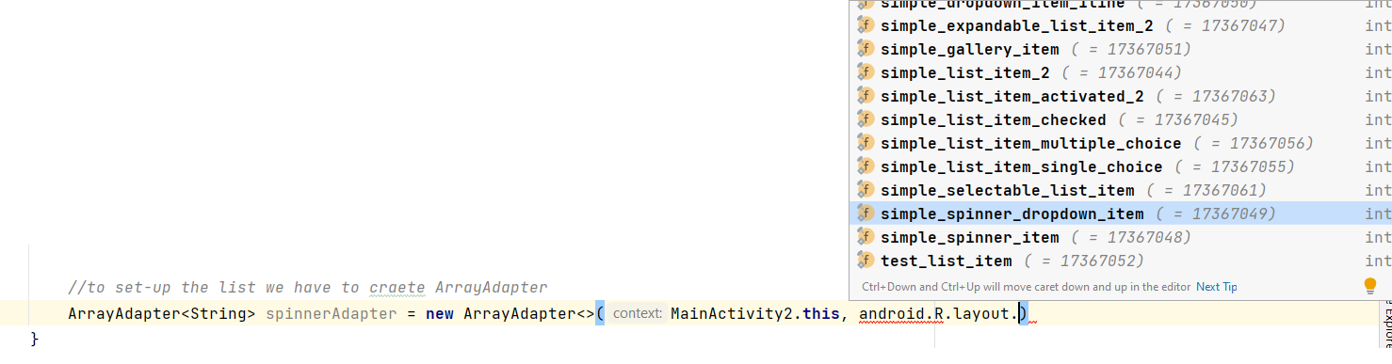
Create ArrayList for spinner
Create an ArrayList for dropdown of spinner.
Note: use the same procedure explained earlier in the slides.
Add items in the ArrayList using add method.
Create ArrayAdapter.
Set ArrayAdapter to the spinner.
Note while creating the ArrayAdapter, when choosing the android layout choose “simple_spinner_dropdown_item” from the popup.

Slide 19
AutoCompleteTextView in Android

Slide 20
Introduction
AutoCompleteTextView is a view that is similar to EditText, except that it shows a list of completion suggestions automatically while the user is typing.
The list of suggestions is displayed in drop down menu.
The user can choose an item from there to replace the content of edit box with.

Slide 21
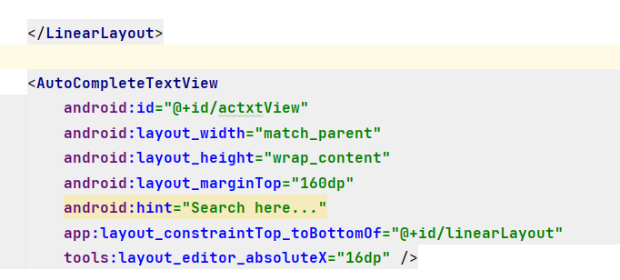
How to add AutoCompleteTextView
You can choose AutoCompleteTextView from the Text tab of your palette.
You can choose width as “match_parent” and height as “wrap_content”.
Give an id, which will be used later on in the java file to code.

Slide 22
Code in java file
Create a variable for AutoCompleteTextView.
Add it’s id with it using the method findViewByID.
Create an ArrayList for dropdown of AutoCompleteTextView.
Note: use the same procedure explained earlier in the slides.
Add items in the ArrayList using add method.
Create ArrayAdapter.
Note while creating the ArrayAdapter, when choosing the android layout choose “simple_list_item_1” from the popup.
Set ArrayAdapter to the AutoCompleteTextView.
Set threshold using AutoCompleteTextView_variable.setThreshold();
We can set threshold for the list, means after how many letter typed by the user, the items from the list should be shown to auto complete the list.
I am giving threshold 1 means, the data items will appear after the user type one letter.
The code is pasted in next slide.

Slide 23
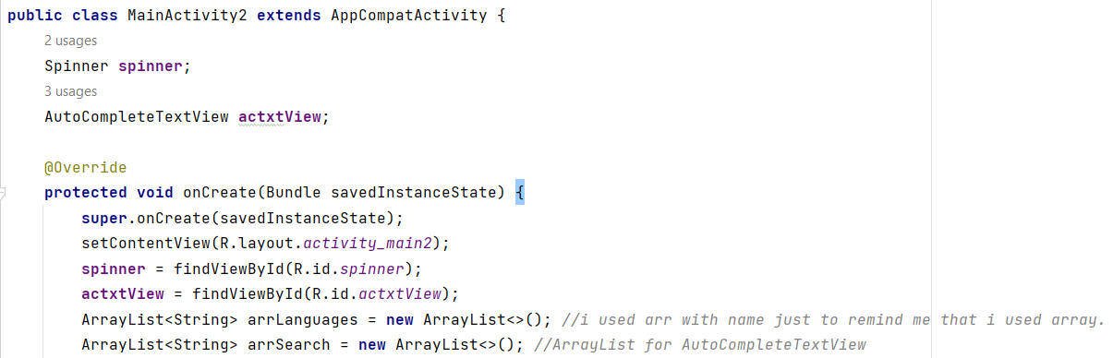
Note:
The above code contains Spinner and AutoCompleteTextView java file code.

Slide 24
